Slide 1


Classes and Objects
Chapter No. : 2
Notes:
‹#›

Slide 2


Topic Learning Outcome
Explain classes and objects
Define constructor and overloading of method to solve a given problem
Apply static members concept to solve a given problem
Define methods with objects as parameter and return value.
Apply nested and inner classes concepts to solve a given problem
Draw class diagrams using UML notations for a given scenario
PS : These topics are primitive steps in understanding Object Oriented Programming.
School of Computer Science & Engineering
Notes:
‹#›

Slide 3
Classes & Objects
Class Fundamentals, Declaring Objects, Assigning Object Reference Variables
Introducing Methods and Constructors
Overloading : Method and Constructor
‘this’Keyword, ‘static’ keyword, Garbage Collection, finalize method
Parameter Passing
Returning Objects
Access Control
Understanding static and final keywords
Nested class and inner classes
School of Computer Science & Engineering
Notes:
‹#›

Slide 4
Class Fundamentals
A class is a description of a kind of object.
A programmer may define a class
Or may use predefined classes that comes in class libraries
A class is merely a plan for a possible object(s). It does not do anything by itself.
When a programmer wants to create an object the new operator is used with the name of the class.
From one class any number of instance can be created.
Creating an object is called instantiation.
School of Computer Science & Engineering
Notes:
‹#›

Slide 5
Class Fundamentals
It is an encapsulation of attributes and methods
FIGURE
class
Ob1
Ob3
CIRCLE
SQUARE
Ob2
RECTANGLE
School of Computer Science & Engineering
Notes:
‹#›

Slide 6
Class Syntax
class <ClassName>
{
attributes/variables;
Constructors();
methods();
}
School of Computer Science & Engineering
Notes:
‹#›

Slide 7
Class Example
class Student
{
int iID;
String sName;
void insertRecord(int iID, String sName){
//method body
}
void displayRecord(){
//method body
}
Student(){
//constructor body
}
}
School of Computer Science & Engineering
Notes:
‹#›

Slide 8
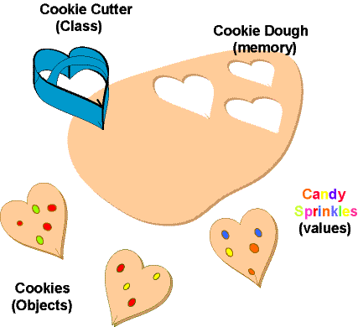
Objects
Object is an instance of a class which is an entity with its own attribute, values and methods.
School of Computer Science & Engineering
Notes:
‹#›

Slide 9
Objects Syntax and Example
An object has three characteristics
State: represents data (value) of an object.
Behavior: represents the behavior (functionality) of an object such as deposit, withdraw etc.
Identity: Object identity is typically implemented via a unique ID. The value of the ID is not visible to the external user. But,it is used internally by the JVM to identify each object uniquely.
<ClassName> <ObjectName> = new <Constructor>;
Student Ravi = new Student();
School of Computer Science & Engineering
Notes:
‹#›

Slide 10
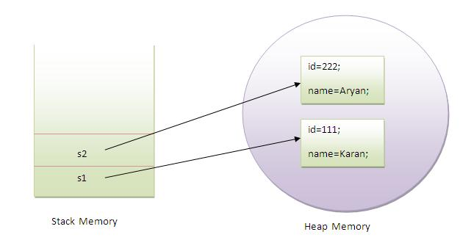
Objects with Memory Allocation
Consider two objects of Student class are created and initializing the value to these objects by invoking the insertRecord method on it.
Here, we are displaying the state (data) of the objects by invoking the displayRecord method.
School of Computer Science & Engineering
Notes:
‹#›

Slide 11
Assigning Object Reference Variable
We can assign value of reference variable to another reference variable.
Reference Variable is used to store the address of the variable.
Assigning Reference will not create distinct copies of Objects.
All reference variables are referring to same Object.
School of Computer Science & Engineering
Notes:
‹#›

Slide 12
Assigning Object Reference Variable
Example
Student Ravi = new Student();
Student Rajesh = Ravi;
Ravi is reference variable which contain the address of Actual Student Object.
Rajesh is another reference variable
Rajesh is initialized with Ravi means – “Ravi and Rajesh” both are referring same object, thus it does not create duplicate object, nor does it allocate extra memory.
School of Computer Science & Engineering
Notes:
‹#›

Slide 13
Methods
In Java Class , We can add user defined method.
Method is equivalent to Functions in C/C++ Programming.
Syntax
<ReturnType> <MethodName> (<ArgumentList>){
//method body
}
ReturnType is nothing but the value to be returned to an calling method.
MethodName is an name of method that we are going to call through any method.
ArgumentList is the different parameters that we are going to pass to a method.
School of Computer Science & Engineering
Notes:
‹#›

Slide 14
Methods
Method can return any type of value.
Method can return any Primitive data type
int sumInteger (int num1,int num2);
Method can return Object of Class Type.
Rectangle sumRectangle (int num1,int num2);
Method sometimes may not return value.
void sumInteger (int num1,int num2);
School of Computer Science & Engineering
Notes:
‹#›

Slide 15
Methods
Method can accept any number of parameters.
Method can accept any data type as parameter.
Method can accept Object as Parameter
Method can accept no Parameter.
Parameters are separated by Comma.
Parameter must have Data Type
Method Definition contain the actual body of the method.
Method can take parameters and can return a value.
School of Computer Science & Engineering
Notes:
‹#›

Slide 16
Methods
Ravi is an Object of Type Student.
We are calling method “insertRecord” by writing –
Syntax
<Object_Name> [DOT] <Method_Name> (<ParameterList>);
Example
Ravi.insertRecord(1,”Ravi”);
Function call is always followed by Semicolon.
School of Computer Science & Engineering
Notes:
‹#›

Slide 17
Constructors
Constructor in java is a special type of method that is used to initialize the object.
Java constructor is invoked at the time of object creation. It constructs the values i.e. provides data for the object that is why it is known as constructor.
There are basically two rules defined for the constructor.
Constructor name must be same as its class name
Constructor must have no explicit return type
There are two types of constructors:
Default constructor (no-arg constructor)
Parameterized constructor
School of Computer Science & Engineering
Notes:
‹#›

Slide 18
Constructors
A constructor that have no parameter is known as default constructor.
Syntax
<ClassName>(){
//constructor body
}
Example
Student(){
//constructor body
}
School of Computer Science & Engineering
Notes:
‹#›

Slide 19
Constructors
A constructor that has parameter is known as parameterized constructor.
Syntax
<ClassName>(<ParameterList>){
//constructor body
}
Example
Student(int iID, String sName){
//constructor body
}
School of Computer Science & Engineering
Notes:
‹#›

Slide 20
Constructors
Some rules of constructor
Constructor Initializes an Object.
Constructor cannot be called like methods.
Constructors are called automatically as soon as object gets created.
Constructor don’t have any return Type. (even Void)
Constructor name is same as that of “Class Name“.
Constructor can accept parameter.
Summary
new Operator will create an object.
As soon as Object gets created it will call Constructor.
Thus Constructor Initializes an Object as soon as after creation.
It will print Values initialized by Constructor.
School of Computer Science & Engineering
Notes:
‹#›

Slide 21
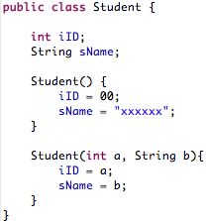
Constructors
Example
School of Computer Science & Engineering
Notes:
‹#›

Slide 22
Method Overloading
If a class have multiple methods by same name but different parameters (signature), it is known as Method Overloading.
If we have to perform only one operation, having same name of the methods increases the readability of the program.
Suppose you have to perform addition of the given numbers but there can be any number of arguments, if you write the method such as sumInteger(int a,int b) for two parameters, and sumInteger(int a,int b,int c) for three parameters then it may be difficult for you as well as other programmers to understand the behavior of the method because its name differs. So, we perform method overloading to figure out the program quickly.
School of Computer Science & Engineering
Notes:
‹#›

Slide 23
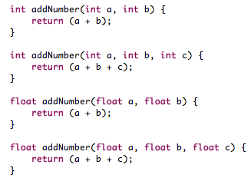

Method Overloading
School of Computer Science & Engineering
Notes:
‹#›

Slide 24

Constructor Overloading
Similar to method overloading, constructor overloading has a multiple constructors by same name but different parameters (signature).
If we have to perform only one operation, having same name of the methods increases the readability of the program.
School of Computer Science & Engineering
Notes:
‹#›

Slide 25
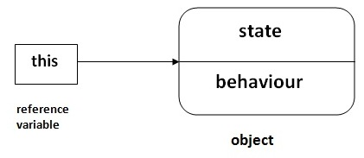
‘this’ keyword
There can be a lot of usage of java this keyword. In java, this is a reference variable that refers to the current object.
this keyword can be used to refer current class instance variable.
this() can be used to invoke current class constructor.
this keyword can be used to invoke current class method (implicitly)
this can be passed as an argument in the method call.
this can be passed as argument in the constructor call.
this keyword can also be used to return the current class instance.
School of Computer Science & Engineering
Notes:
‹#›

Slide 26


‘this’ keyword
this keyword can be used to refer current class instance variable.
this can be used to invoke current class constructor.
this keyword can be used to invoke current class method (implicitly)
School of Computer Science & Engineering
Notes:
‹#›

Slide 27
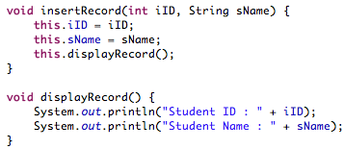

‘this’ keyword
this keyword can be used to invoke current class method (implicitly)
School of Computer Science & Engineering
Notes:
‹#›

Slide 28
Garbage Collection
In java, garbage means unreferenced objects.
Garbage Collection is process of reclaiming the runtime unused memory automatically. In other words, it is a way to destroy the unused objects.
To do so, we were using free() function in C language and delete() in C++. But, in java it is performed automatically. So, java provides better memory management.
Advantages of Garbage Collection
It makes java memory efficient because garbage collector removes the unreferenced objects from heap memory.
It is automatically done by the garbage collector(a part of JVM) so we don't need to make extra efforts.
School of Computer Science & Engineering
Notes:
‹#›

Slide 29
Garbage Collection
There are many ways:
By nulling the reference
By assigning a reference to another
By anonymous object etc.
By nulling a reference :
Employee e = new Employee();
e = null;
By assigning a reference to another:
Employee e1=new Employee();
Employee e2=new Employee();
e1=e2; //now the first object referred by e1 is available for garbage collection
By anonymous object:
new Employee();
School of Computer Science & Engineering
Notes:
‹#›

Slide 30
Garbage Collection : Methods
finalize() method : The finalize() method is invoked each time before the object is garbage collected. This method can be used to perform cleanup processing. This method is defined in Object class as :
protected void finalize(){}
Note: The Garbage collector of JVM collects only those objects that are created by new keyword. So if you have created any object without new, you can use finalize method to perform cleanup processing (destroying remaining objects).
School of Computer Science & Engineering
Notes:
‹#›

Slide 31
Garbage Collection : Methods
gc() method : The gc() method is used to invoke the garbage collector to perform cleanup processing. The gc() is found in System and Runtime classes.
public static void gc(){}
Note: Garbage collection is performed by a daemon thread called Garbage Collector(GC). This thread calls the finalize() method before object is garbage collected.
School of Computer Science & Engineering
Notes:
‹#›

Slide 32
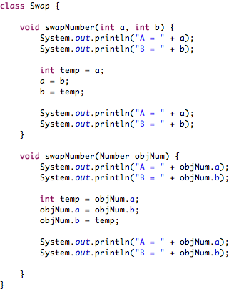
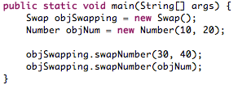
Passing Parameters
School of Computer Science & Engineering
Notes:
‹#›

Slide 33
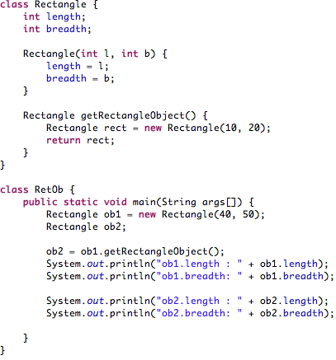
Passing Parameters
School of Computer Science & Engineering
Notes:
‹#›

Slide 34
Access Control (or Modifier)
There are two types of modifiers in java: access modifiers and non-access modifiers.
The access modifiers in java specifies accessibility (scope) of a data member, method, constructor or class.
There are 4 types of java access modifiers:
default
private
protected
public
There are many non-access modifiers such as static, abstract, synchronized, native, volatile, transient etc.
School of Computer Science & Engineering
Notes:
‹#›

Slide 35
Access Control (or Modifier)
Access Modifier | Within Class | Within Package | Outside Package by Subclass only | Outside Package
Default | Y | Y | N | N
Private | Y | N | N | N
Protected | N | Y | Y | Y
Public | Y | Y | Y | Y
School of Computer Science & Engineering
Notes:
‹#›

Slide 36
‘static’ keyword
The static keyword in java is used for memory management mainly.
We can apply java static keyword with variables, methods, blocks and nested class.
The static keyword belongs to the class than instance of the class.
The static can be:
variable (also known as class variable)
method (also known as class method)
block
nested class
School of Computer Science & Engineering
Notes:
‹#›

Slide 37
‘static’ keyword
Static variable
If you declare any variable as static, it is known static variable.
The static variable can be used to refer the common property of all objects e.g. company name of employees, college name of students etc.
The static variable gets memory only once in class area at the time of class loading.
It makes your program memory efficient (i.e it saves memory).
School of Computer Science & Engineering
Notes:
‹#›

Slide 38
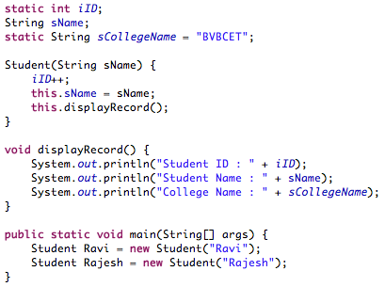
‘static’ variable
School of Computer Science & Engineering
Notes:
‹#›

Slide 39
‘static’ method
If you apply static keyword with any method, it is known as static method.
A static method belongs to the class rather than object of a class.
A static method can be invoked without the need for creating an instance of a class.
static method can access static data member and can change the value of it.
School of Computer Science & Engineering
Notes:
‹#›

Slide 40
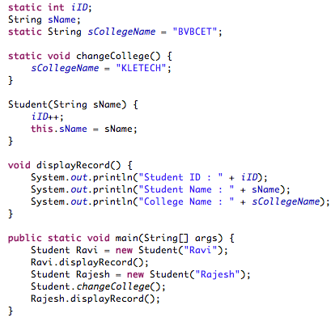
‘static’ method
Example
School of Computer Science & Engineering
Notes:
‹#›

Slide 41
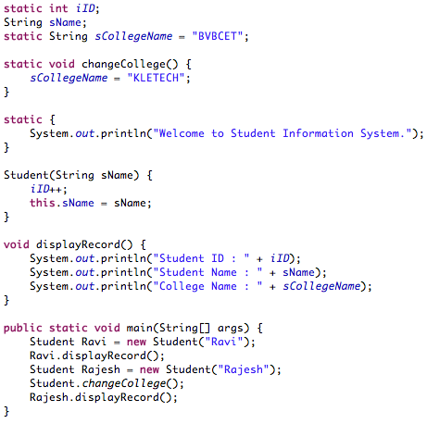
‘static’ block
Is used to initialize the static data member.
It is executed before main method at the time of classloading.
Example
School of Computer Science & Engineering
Notes:
‹#›

Slide 42
‘final’ keyword
The final keyword in java is used to restrict the user. The java final keyword can be used in many context. Final can be:
variable
method
class
School of Computer Science & Engineering
Notes:
‹#›

Slide 43
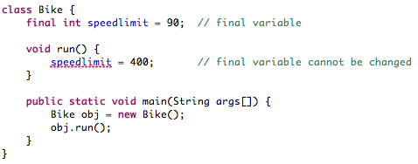
‘final’ variable
If you make any variable as final, you cannot change the value of final variable (It will be constant).
School of Computer Science & Engineering
Notes:
‹#›

Slide 44
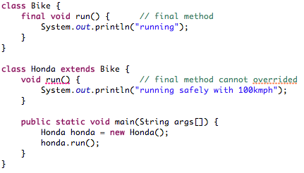
‘final’ method
If you make any method as final, you cannot override it.
School of Computer Science & Engineering
Notes:
‹#›

Slide 45
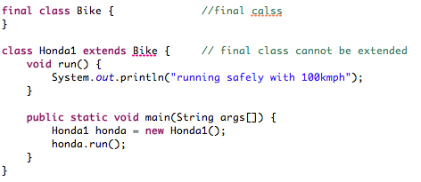
‘final’ class
If you make any class as final, you cannot extend it.
School of Computer Science & Engineering
Notes:
‹#›

Slide 46

Nested Class or Inner Classes
Java inner class or nested class is a class i.e. declared inside the class or interface.
We use inner classes to logically group classes and interfaces in one place so that it can be more readable and maintainable.
Additionally, it can access all the members of outer class including private data members and methods.
School of Computer Science & Engineering
Notes:
‹#›

Slide 47
Advantages
There are basically three advantages of inner classes in java. They are as follows:
Nested classes represent a special type of relationship that is it can access all the members (data members and methods) of outer class including private.
Nested classes are used to develop more readable and maintainable code because it logically group classes and interfaces in one place only.
Code Optimization : It requires less code to write.
School of Computer Science & Engineering
Notes:
‹#›

Slide 48
Types of Inner Class
Types | Description
Member Inner Class | A class created within class and outside method.
Anonymous Inner Class | A class created for implementing interface or extending class. Its name is decided by the java compiler.
Local Inner Class | A class created within method.
Static Nested Class | A static class created within class.
Nested Interface | An interface created within class or interface.
School of Computer Science & Engineering
Notes:
‹#›

Slide 49
Model Questions
What is class and object? Write a program demonstrating access of same object with more than one reference? (L2)
Write a class ‘MyName’ with following members ( private String privateName; public String publicName; String defaultName; )
Include multiple constructors to initialize the data members
Include a method to fetch privateName which can be invoked outside the class
Write a test programs to create two objects of MyName using constructors and print the members of both the objects.
(L3)
School of Computer Science & Engineering
Notes:
‹#›

Slide 50
Model Questions
Draw a class diagram for the following scenario :
Consider a bank "ABC Bank" which provides a banking services and to start with customer can open a bank account. The account can be Savingsaccount / CurrentAccount and there is no interest paid for CurrentAccount. The other services are, the customer can debit and credit amount to BankAccount. The customer is allowed to get the status of his accounts at any time and he can transfer amount from one account to another account.
(L3)
School of Computer Science & Engineering
Notes:
‹#›

Slide 51
Model Questions
A department cannot exist without college. Create classes called as College {name, department, colCode} and Department {name, depCode, numOfStu} within College class.
Define method in College class to create various departments.
Define a method to calculate total strength of students of a college.
Write a test program to create few colleges and departments within it. Then print the total number of students of each college
(L3)
Explain the need of method overloading with a suitable example. (L2)
School of Computer Science & Engineering
Notes:
‹#›

Slide 52
Model Questions
Consider a Student(stuId, stuName, semester), register for 4 courses, Course (courseNo, courseTitle, courseDuration(numberOfhours), fevoriteCourse). The student can view all the courses registered and mark the courses as favorite during registration. Write a method to return the favorite courses and display. Identify the type of relationship, appropriate methods and write a tester class to demonstrate register courses by a student, and display favorite courses.
(L3)
School of Computer Science & Engineering
Notes:
‹#›

Slide 53
Model Questions
Consider a Customer (customerId, customerName, phoneNum, billAmount ) and the shop classifies customer as regular customer and privileged customer. The shop offers discount of 5% on every purchase by a regular customer and it issues a membership card to a privileged customer and offer will be always better than regular customer. The shop prepares a list of customers (regular and privileged randomly) visited shop and view the bill amount of individual customer and total bill amount of all the customers. Display count of regular customers and privileged customers. Write a java program to simulate the above scenario.
(L3)
School of Computer Science & Engineering
Notes:
‹#›

Slide 54
Interview Questions
Define class and object. Explain them with an example using java
What is a method? Provide several signatures of the methods
Define class and object. Explain them with an example using java
What is a method? Provide several signatures of the methods
Difference between instance variable and a class variable
Explain how to create instance of a class by giving an example
What is a native method?
Difference between a public and a non-public class
How are this() used with constructors?
School of Computer Science & Engineering
Notes:
‹#›

Slide 55





Let me know your suggestion
Notes:
‹#›

